Slide 1
Parameter Tampering, manipulate the request/query,
By : Vivek k

Slide 2
Agenda
Introduction
Research
Data collection
Exploitation
Impact Analysis
Mitigation
Proof of concept
Conclusion
Reference

Slide 3
Introduction
Parameter tampering is a type of security attack where parameters exchanged between a client (such as a web browser) and a server are altered by an attacker to gain unauthorized access to data or to exploit vulnerabilities. These parameters are typically part of HTTP requests, such as query strings, form fields, cookies, or HTTP headers.
The goal of parameter tampering can vary depending on the attacker's
Data Manipulation: Attackers may modify parameters to change data being sent to the server or received by the client. For example, altering the price of a product in an online shopping cart by modifying the corresponding parameter in the request.
Privilege Escalation: By modifying parameters related to user authentication or authorization, attackers can attempt to escalate their privileges. For instance, changing a user's role from regular user to administrator by manipulating parameters in an HTTP request.

Slide 4
Information Disclosure: Attackers can exploit parameter tampering to access sensitive information that is not meant to be exposed. This could involve modifying parameters to access another user's private data or backend system information.
Denial of Service (DoS): In some cases, attackers may manipulate parameters to cause denial of service by overwhelming server resources. For example, sending a large number of requests with manipulated parameters that consume excessive server resources.

Slide 5
Research and Data collection
Used Google dorks to find the website.
Used wappalyzer extension for identifying the technologies behind websites.
About website
https://nuskhebyparas.com/
Type: cosmetics and Beauty products website.

Slide 6
Exploitation
In E-commerce website I found the Authentication Bypass vulnerability.
Attackers can modify parameters related to authentication, such as usernames, passwords, session IDs, or tokens, in an attempt to gain unauthorized access to a system or escalate their privileges.
In e-commerce applications, attackers may modify parameters related to product prices or discounts during checkout, leading to financial losses for the business or unauthorized purchases at lower prices.

Slide 7
Exploitation
The Goal: An attacker wants to access something they shouldn’t, like user data or administrative controls.
The exploit: they exploit weakness in the website’s authentication process to bypass the may modify parameters related to product prices or discounts during checkout, leading to financial losses for the business or unauthorized purchases at lower prices.

Slide 8
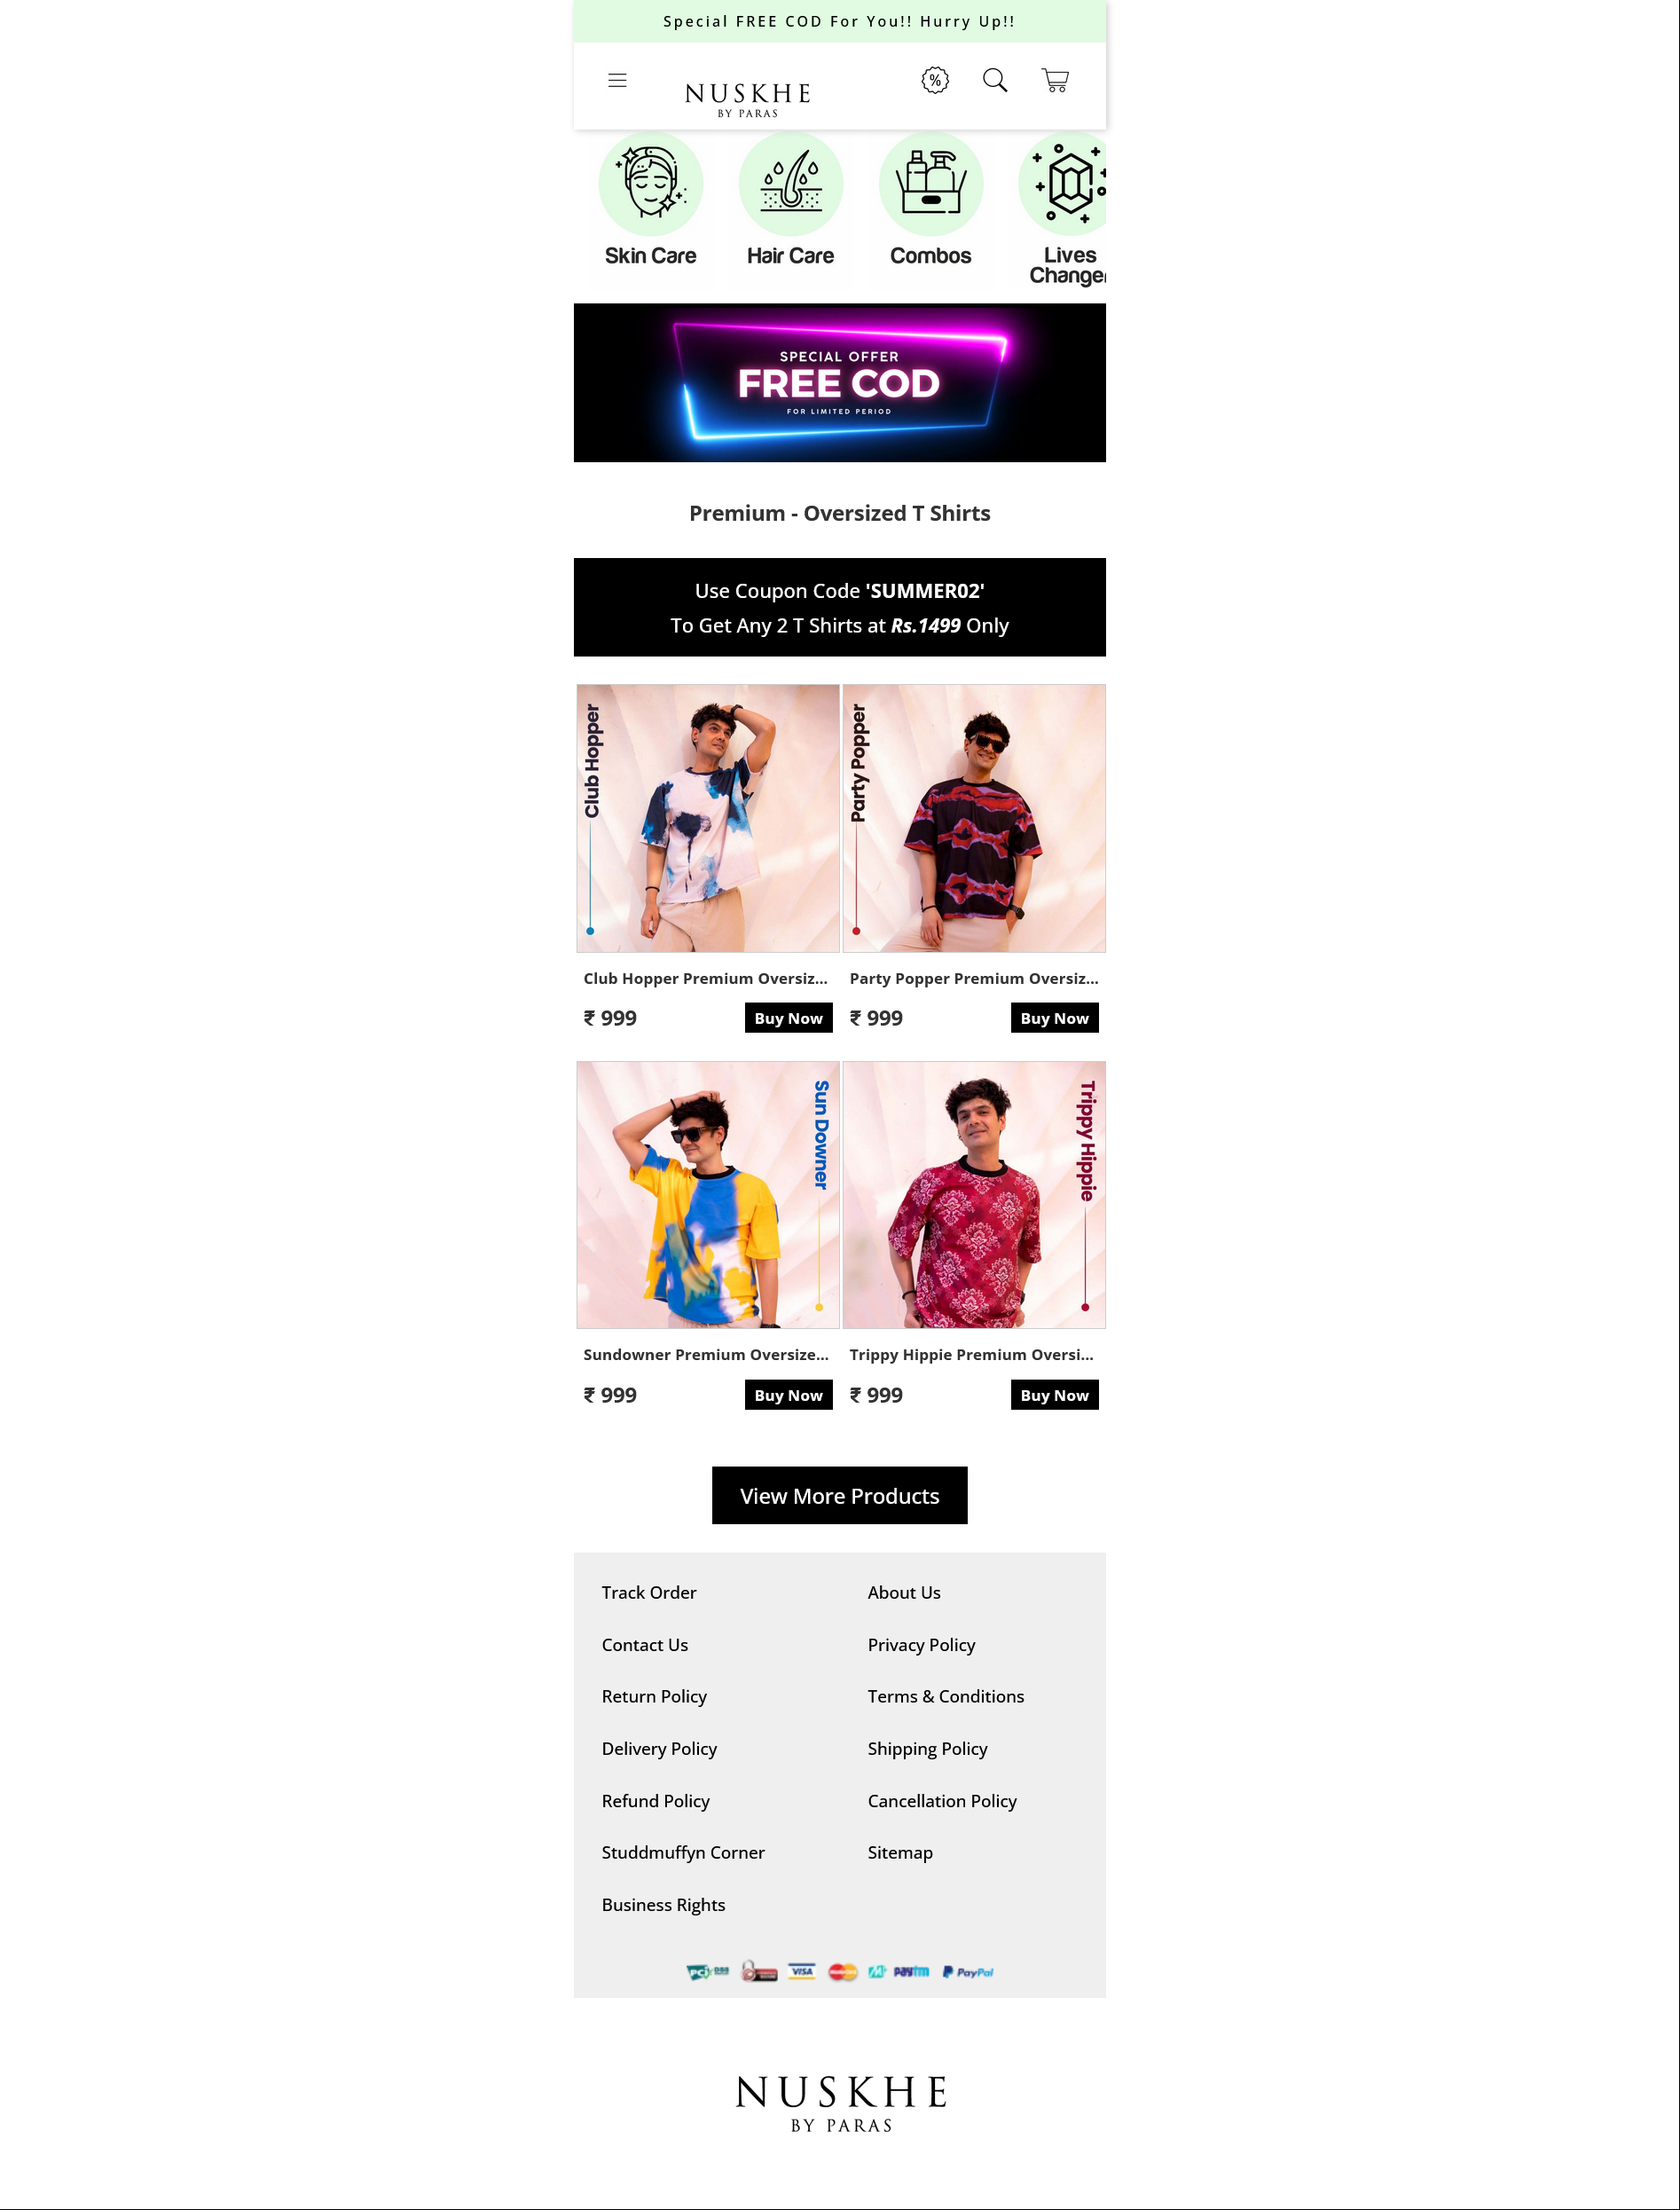
Open a e- commerce website and find the main page (poC)

Slide 9
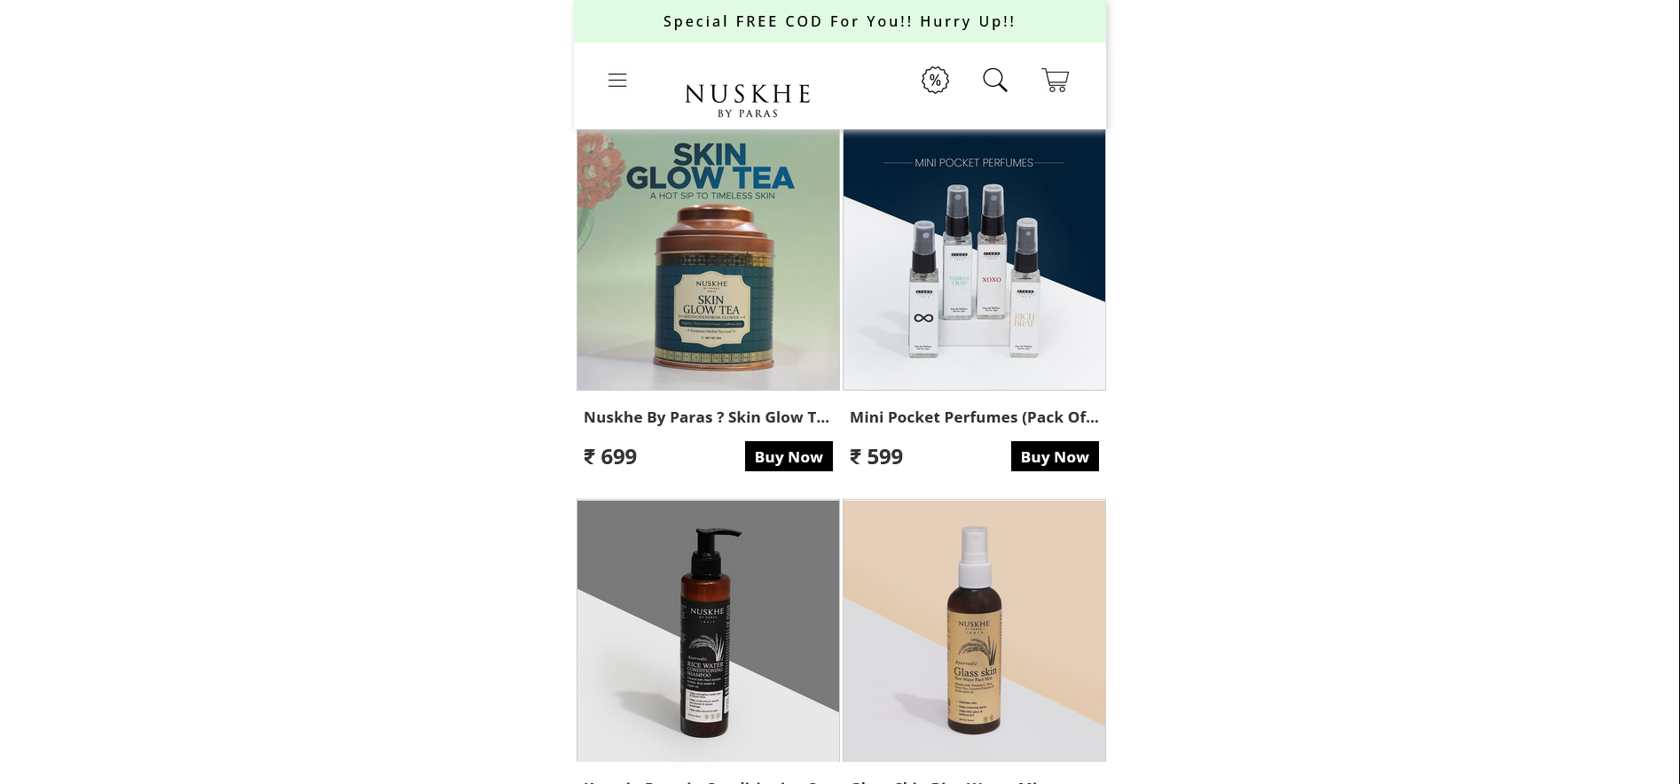
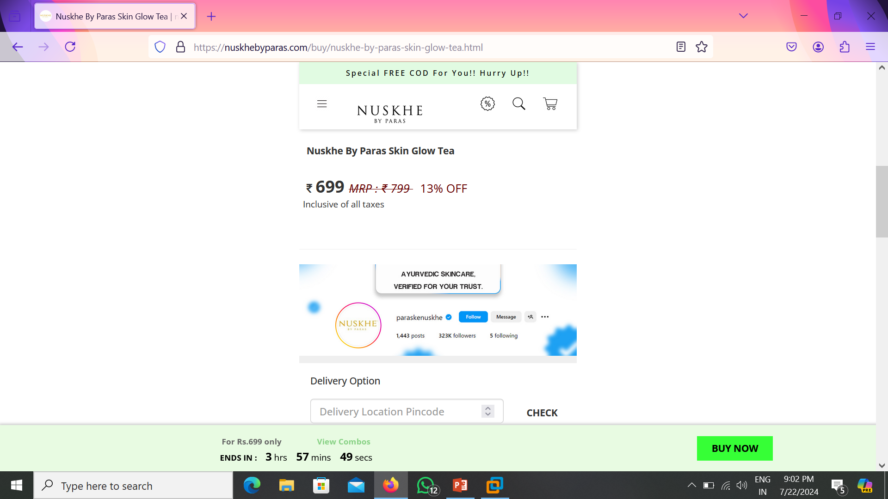
Next we have to select the product as you like

Slide 10
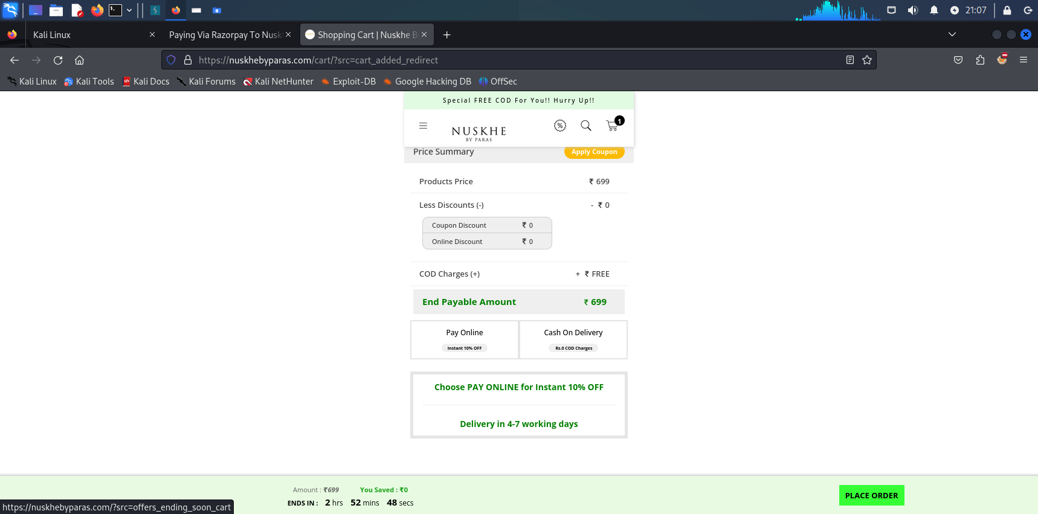
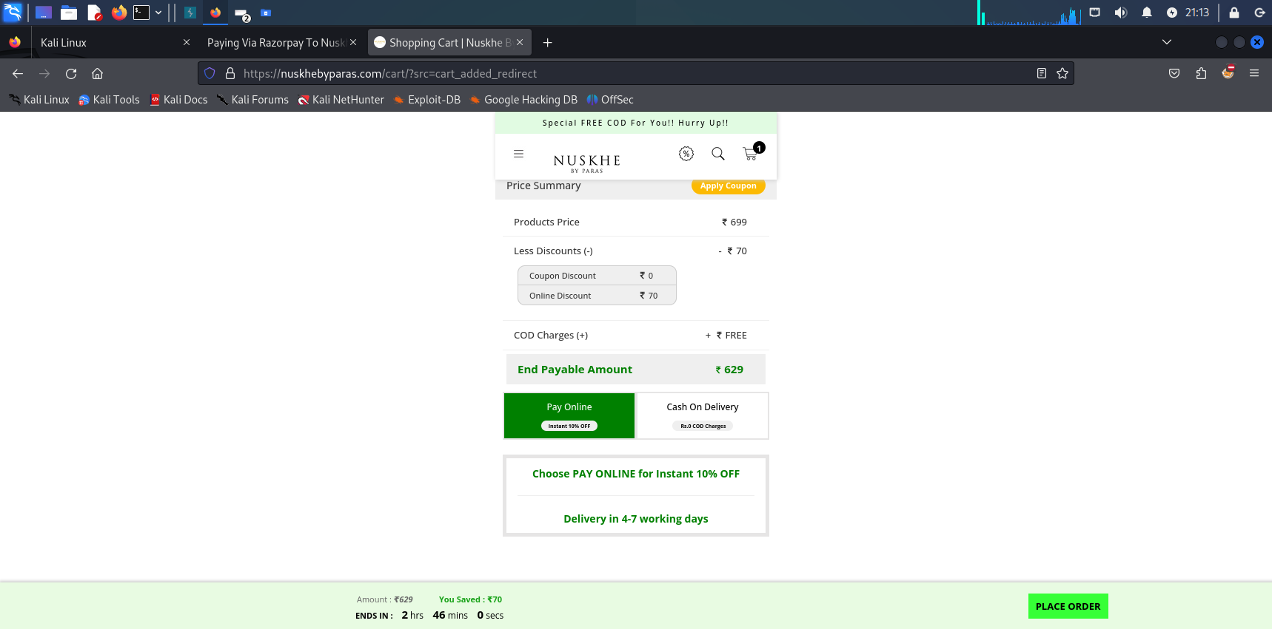
Then select and buy the product and pay online amount

Slide 11
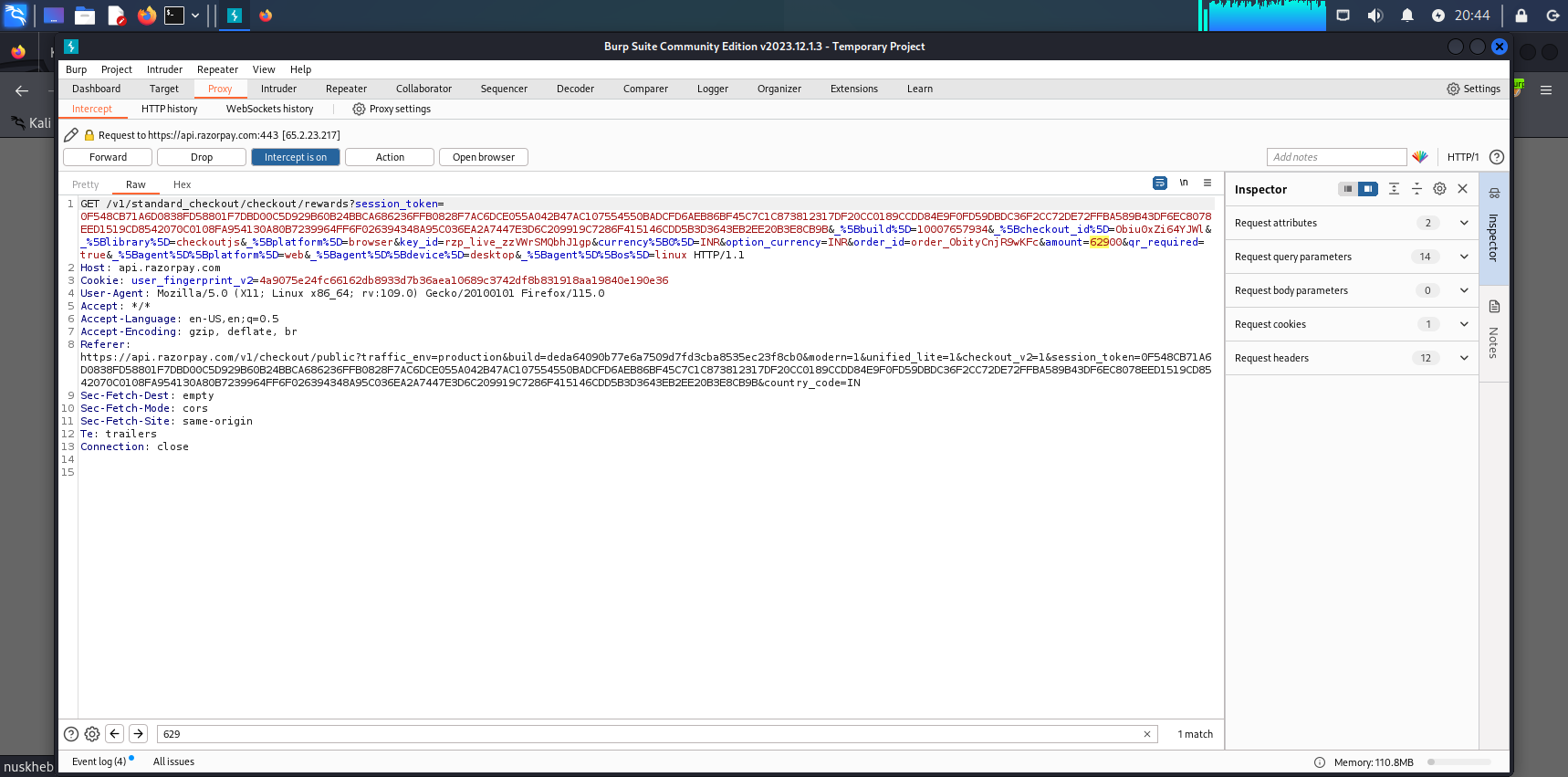
Turn on the burp suite and capture the prize list

Slide 12
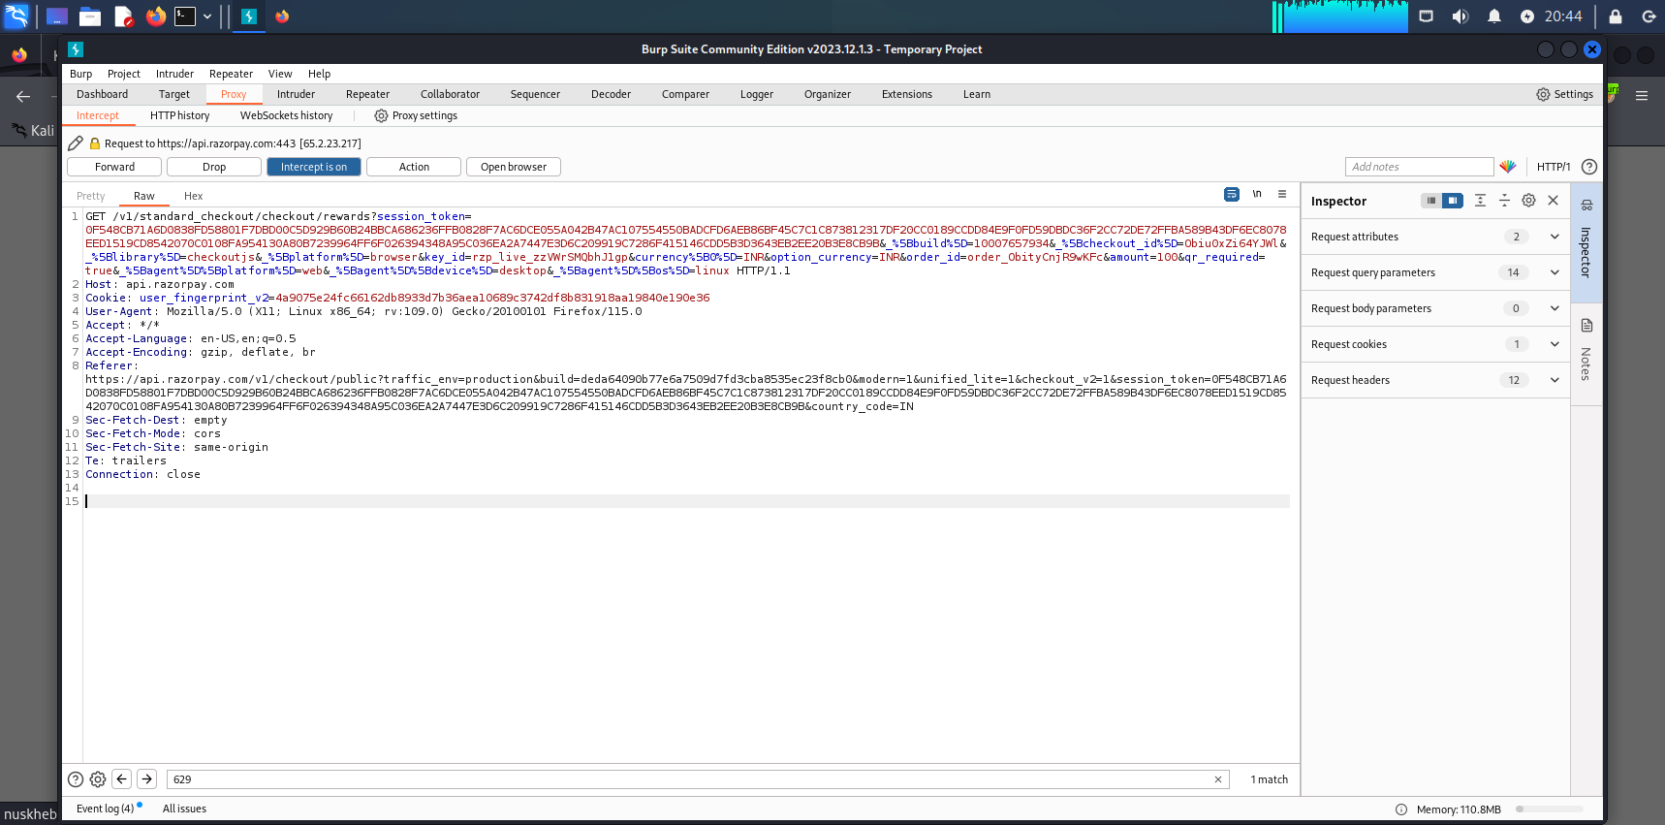
Then we can manipulate(tampering) the prize 629 to 1rs

Slide 13
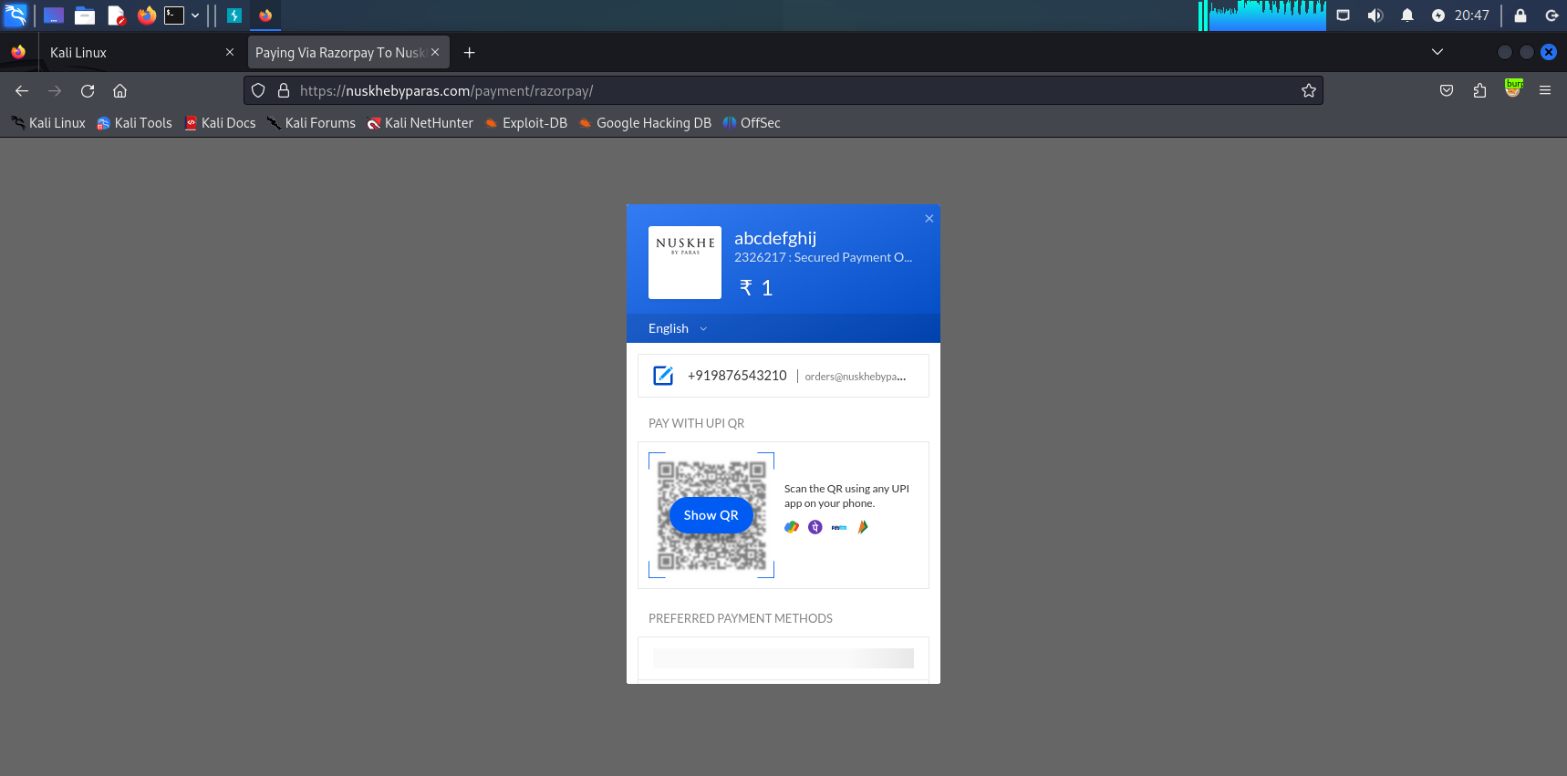
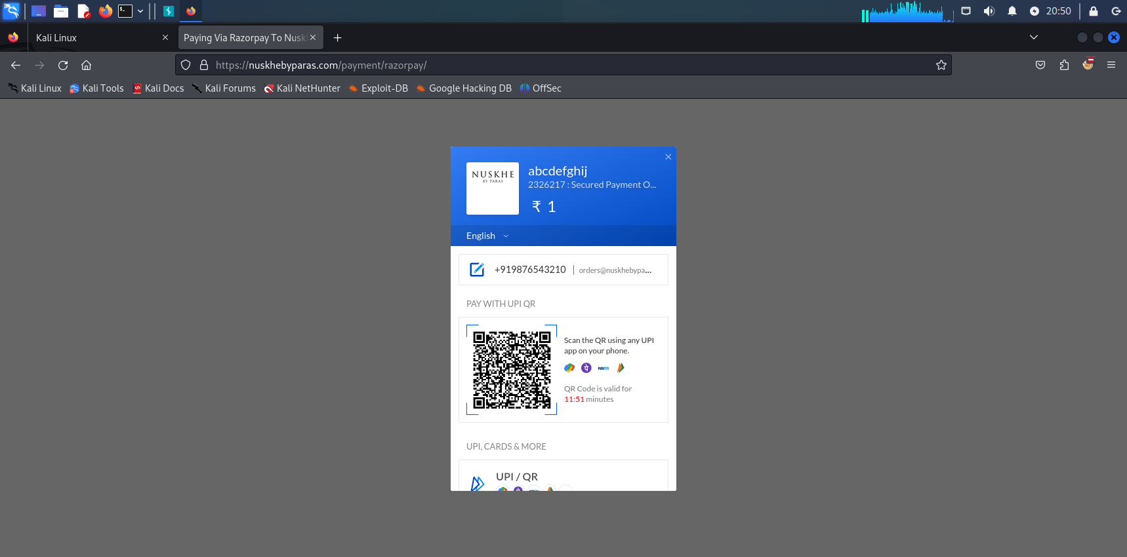
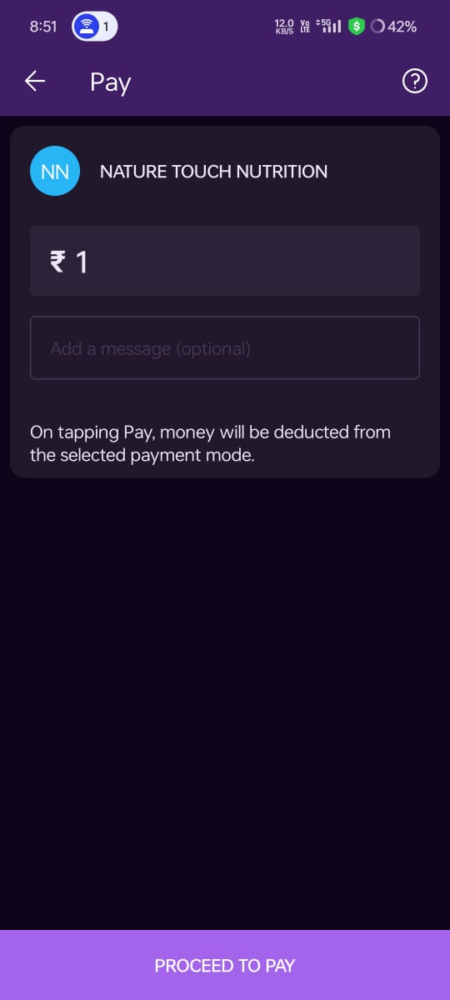
Finally we are successfully manipulated the prize (not suggested because it’s illegal)

Slide 14
Impact Analysis
An attacker might use the bypass to target specific accounts or data sets.
The easier it is to exploit the vulnerability, the higher the risk.
If the vulnerability becomes publicly known, attackers are more likely to try exploit it
Input Validation and Sanitization: Use whitelisting approaches where possible to validate inputs against a list of known valid values or patterns.
Parameter Encryption and Integrity Checking: Encrypt sensitive parameters or data to ensure confidentiality.
Parameter Tampering Detection: Implement logging and monitoring mechanisms to detect unusual or suspicious activities related to parameter values. Monitor for unexpected changes in parameter values, especially those related to user authentication, roles, or permissions.

Slide 15
Mitigations
Mitigating parameter tampering requires a multi-layered approach that addresses both the technical aspects of the application's design and implementation, as well as operational practices to detect and respond to potential tampering attempts.
Input Validation: Implement strong validation checks on both the client-side (for user input) and server-side (for data received from clients). Validate data types, length, format, and range to prevent unexpected or malicious input.
Session Management: Manage sessions securely by using session tokens with short lifetimes, employing mechanisms like CSRF tokens to prevent cross-site request forgery attacks, and ensuring sessions are invalidated securely upon logout or timeout.
Authentication and Authorization: Implement robust authentication mechanisms to verify the identity of users and ensure they have appropriate permissions for accessing and modifying data. This helps prevent unauthorized parameter modifications.
Mitigations should layered to create a defense on depth approach . No single mitigation is foolproof.

Slide 16
conclusion
Parameter tampering refers to a serious security threat where attackers manipulate data exchanged between clients and servers to gain unauthorized access or privileges. Detecting and preventing such tampering is crucial to maintaining data integrity and user trust.
By implementing robust encryption, secure communication protocols, and thorough validation checks, organizations can effectively safeguard against parameter tampering attacks. Vigilance and proactive security measures are essential in mitigating this threat and ensuring the integrity and confidentiality of sensitive information.

Slide 17
References
Google dorks:
https://en.wikipedia.org/wiki/Google_hacking
OWASP: https://cheatsheetseries.owasp.org/cheatsheets/Query_Parameterization_Cheat_Sheet.html
YouTube:
https://youtu.be/RV7KBJnwzAM?si=-YwxMDhNjdWOSG8B

Slide 18
Questions ?

Slide 19
Thank You!

